Slide 1
Tutorial #9 H8s/2378 Programming
Dr. Sundaram Suresh Microprocessor Programming

Slide 2
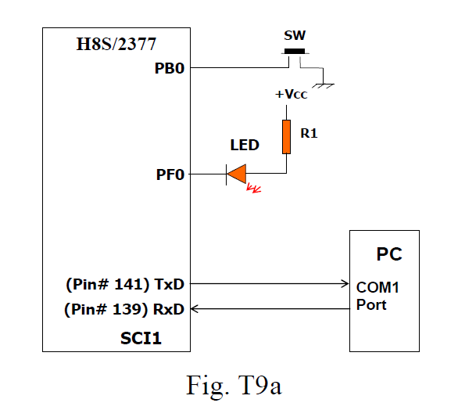
Problem Definition (Question 9.2)
Switch (SW) and LED are interfaced with port B and F.
Port B pin PB0 is input port
Port F pin PF0 is output port.
PC is connected via serial communication SCI1.

Slide 3
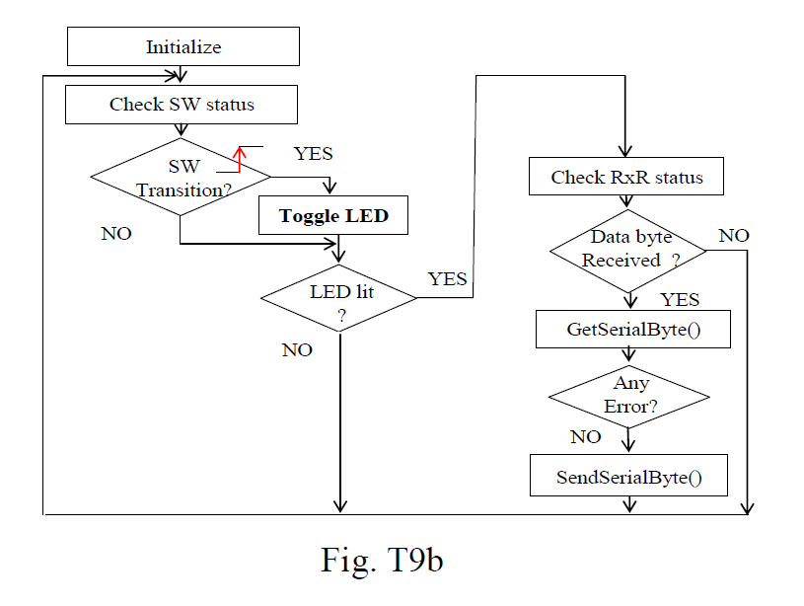
Problem Definition (Q 9.2)

Slide 4
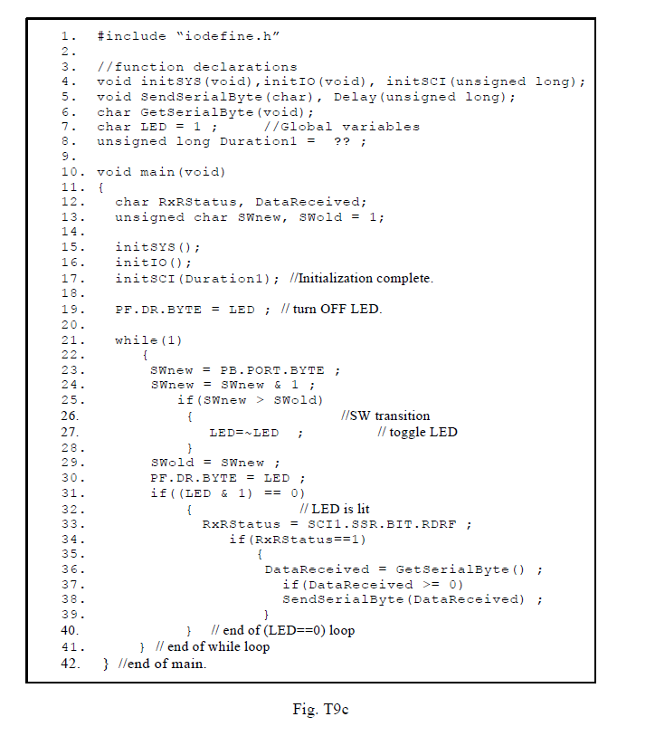
Logical steps in the Program (Q 9.2)

Slide 5
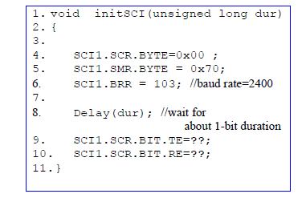
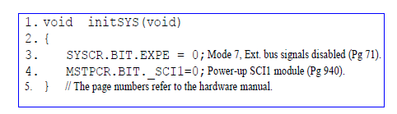
Functions initSYS and initSCI

Slide 6
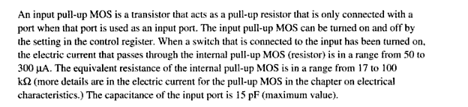
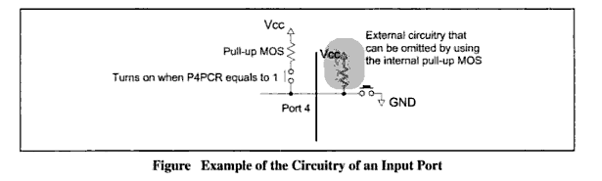
What is MOS Setting?

Slide 7
Different register in serial communication
Serial Mode Register (SMR) H’FFFF80
SMR is used to set the SCI’s serial transfer format and select the on-chip baud rate generator clock source.
Bit Rate Register (BRR) H’FFFF81
BRR is an 8-bit register that adjusts the bit rate.
Serial Control Register (SCR) H’FFFF82
SCR performs enabling or disabling of SCI transfer operations and interrupt requests, and selection of the transfer/receive clock source.
Transmit Data Register (TDR) H’FFFF83
TDR is an 8-bit register that stores transmit data.
Serial Status Register (SSR) H’FFFF84
SSR is a register containing status flags of the SCI and multiprocessor bits for transfer.
Receive Data Register (RDR) H’FFFF85
RDR is an 8-bit register that stores receive data.

Slide 8
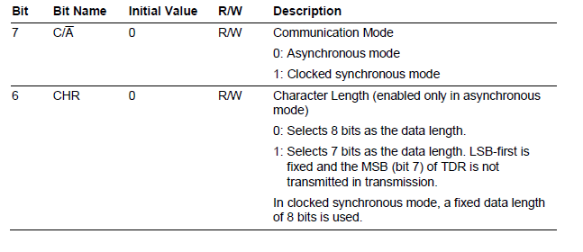
SMR

Slide 9
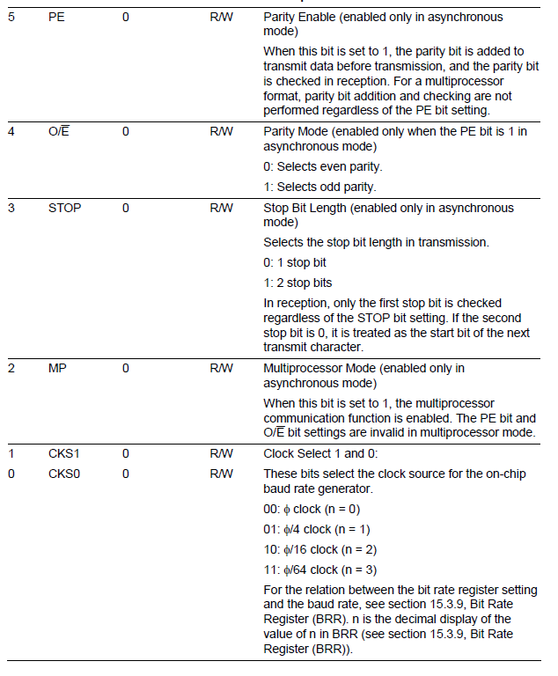
SMR

Slide 10
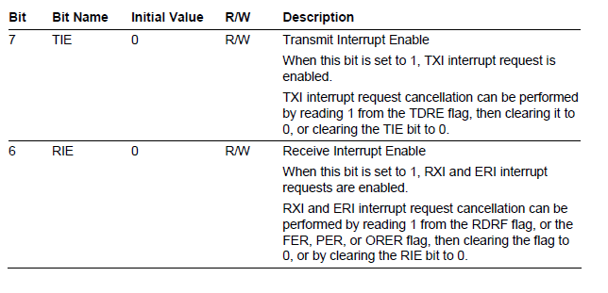
SCR

Slide 11
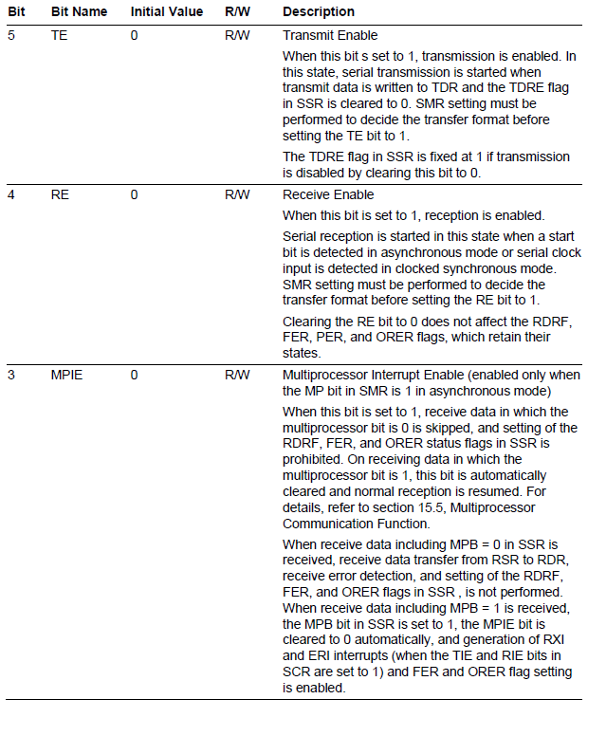
SCR

Slide 12
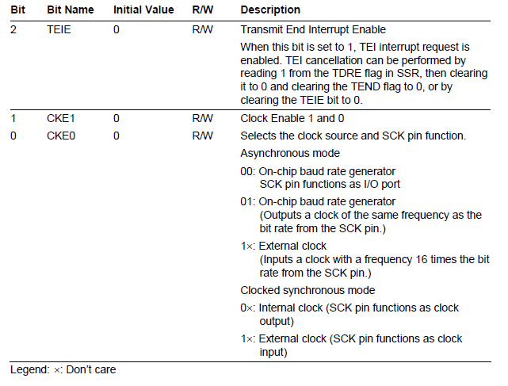
SCR

Slide 13
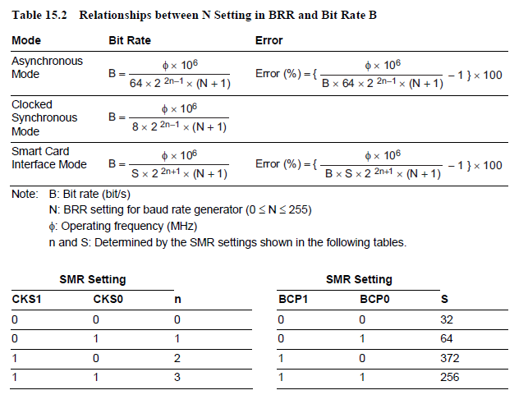
BRR

Slide 14
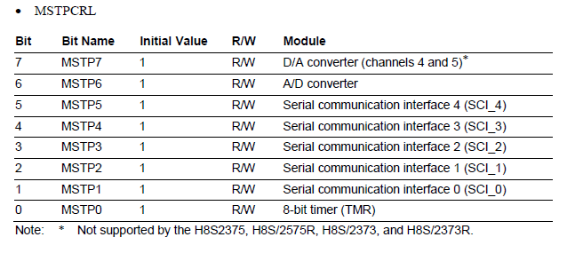
Module Stop Control Registers
MSTPCRL Address H’FFFF41

Slide 15
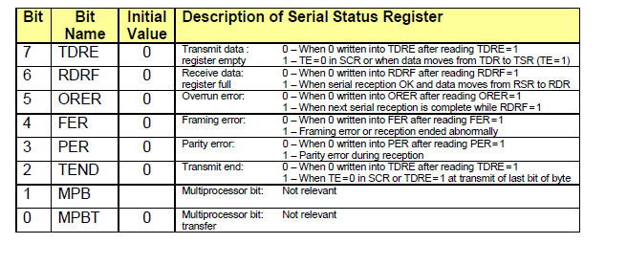
SSR

